Slide 1
BUILD A BINARY SEARCH TREE
Presented by : Praveen
Faculty Advisor : Dr. Victor Govindaswamy

Slide 2
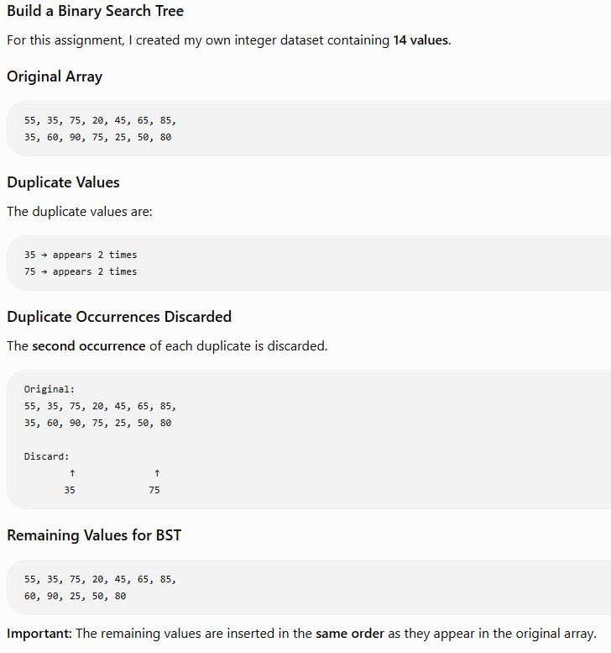
ORIGINAL DATASET & DUPLICATES

Slide 3
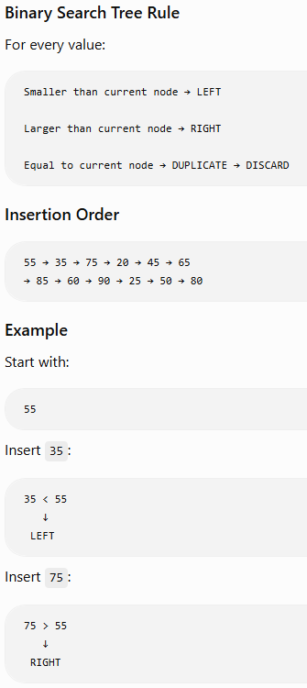
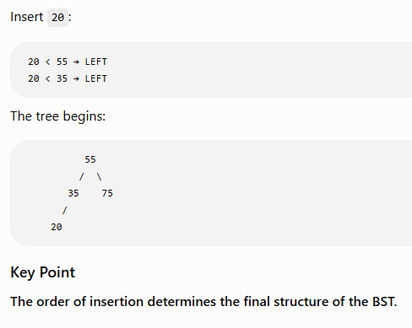
BST INSERTION PROCESS

Slide 4
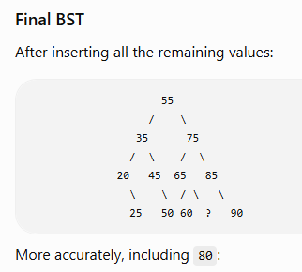
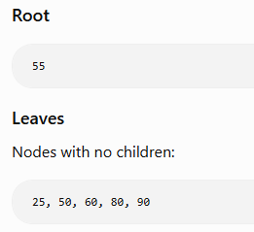
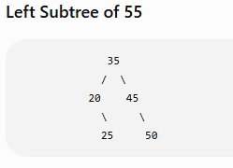
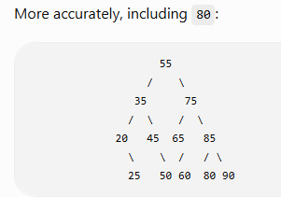
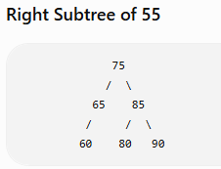
COMPLETED BINARY SEARCH TREE

Slide 5
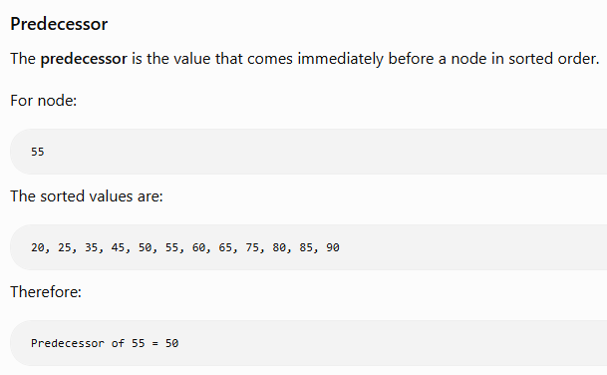
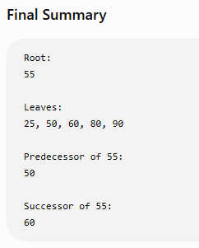

PREDECESSOR & SUCCESSOR

